Slide 1
An overview of project practice from the slides to guide the second assessment.
NOTE: All of these slides are available in Moodle. Please refer to each week for clarity of understanding.

Slide 2
Academic practice applied to a project: An example
An event approach
Identifying the critical path
After estimating the time completion of activities, the manager must identify the critical path of the project by investigating the network diagram and recognising the longest time duration in the path. Then, the project manager can set the priority level for each work package according to the network diagram (Harrison & Lock, 2017; Smartsheet.com, 2015). If several critical paths are found, time will be a sensitive issue for the project. Monitoring these critical paths are required to elude schedule delay (Leach, 2014).
OP’s conference has several work packages with various time completions, and it is essential to determine the critical path to enable the project manager to prioritise the “critical” part (the longest path) and then move towards the “float” part (which does not affect project duration if delayed). In other words, the project manager can allocate resources based on priority levels, working from the critical path towards non-critical activities (Harrison & Lock, 2017; Hegazy & Menesi, 2010).
Network diagram
The main purpose of a network diagram is to plot out activities and dependencies visually to support the main program report (Project Management Institute, 2013; Kerzner, 2013). The network diagram is identified by Passenheim (2009) as a tool that aids project managers in efficiently mapping out activities, improving transparency on objectives, risks assessment (Choles Arvilla, 2014) and evaluating possible delays that may affect the project schedule.
It is therefore appropriate to apply such methodology to events management since it allows the entire team to understand relationships between tasks within a project. As supported by Bowdin, Allen, O’Toole, Harris, & McDonnell (2012), networks provide for a useful tool in controlling task timelines and communication among team members.
Utilising networks for events management is supported by several authors (Raj, Walters, & Rashid, 2017; Bladen, Kennell, Abson, & Wilde, 2017; Van Der Wagen & White, 2018) because network analysis is beneficial for multi-tasking purposes as it offers opportunity to work on several activities simultaneously and accomplishing more within a shorter timeframe. It will provide the project with the advantage of an organised activity layout and the ability to identify time-cost trade-offs (Kerzner, 2013).
CPM’s structured critical path though rigid (Bowdin et al., 2012) can be supported by kanban’s flexibility in dealing with activities that may require scope changes and would provide for quick task turnovers (Axelos, 2017).

Slide 3


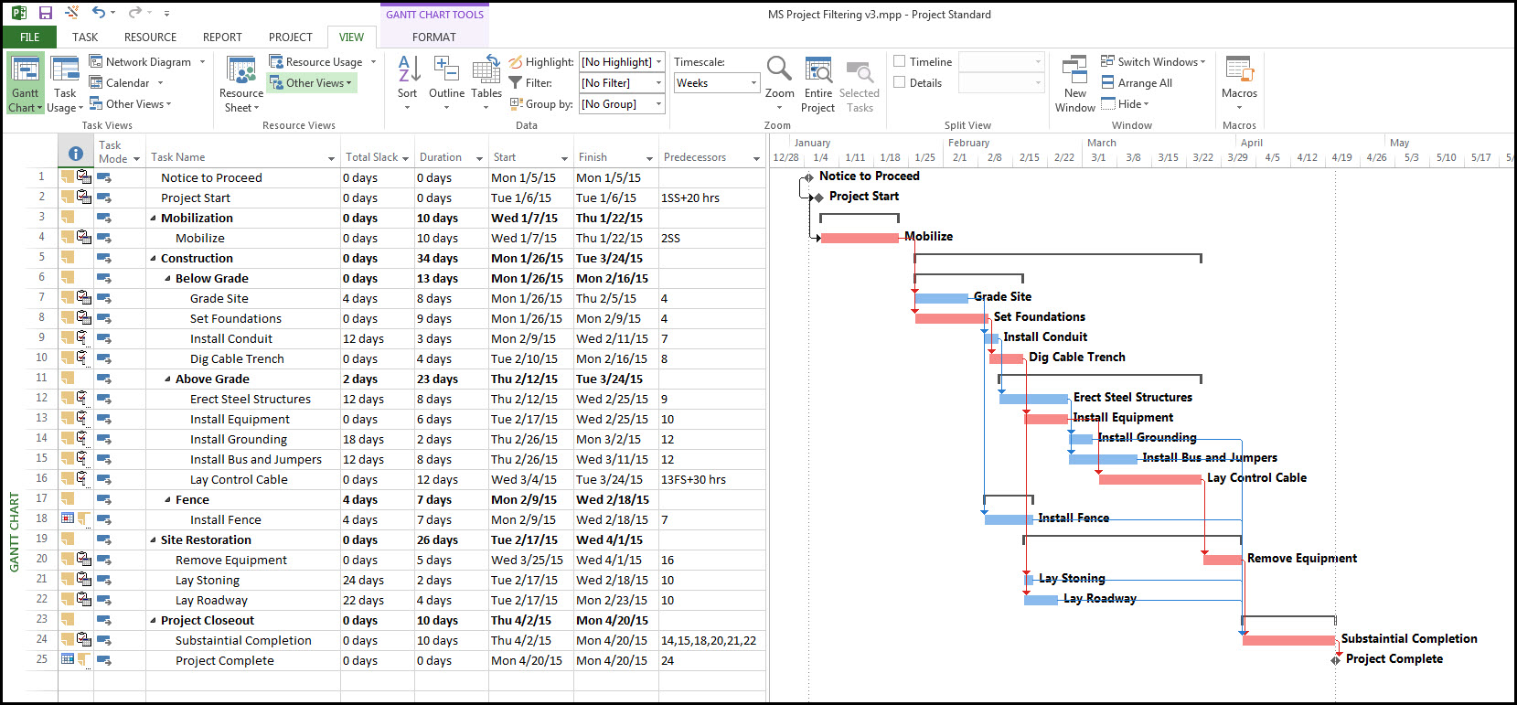
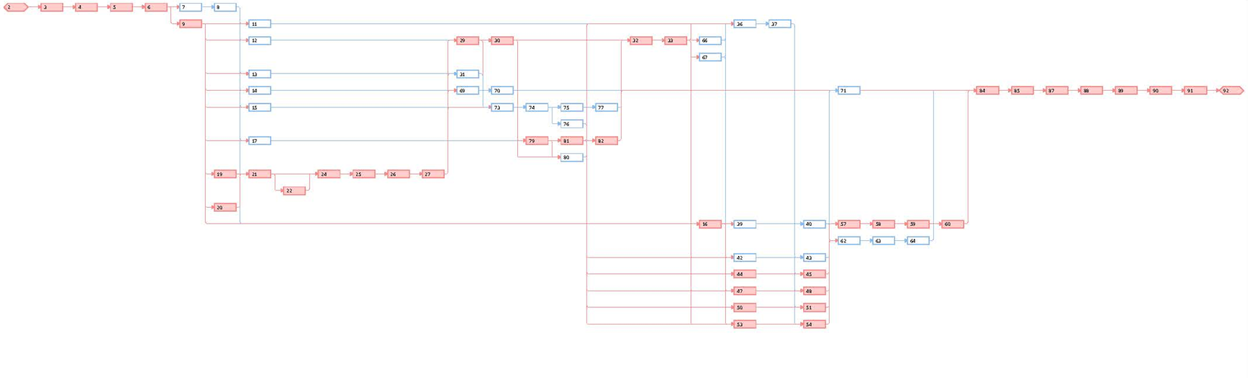
Parts of a Project Plan
Executive summary (project overview)
Project objectives
Project assumptions and risks
Project milestones
Work breakdown structure
Network diagram
Resource details
Human resources
Equipment
Materials and suppliers
Budget details
Project organization
Operating procedures
Assessment and review standards
Contact points and information sources
Project approvals
(Microsoft Project, 2016)
Notes:
There are 13 sections in a project plan, and if we look down the headings for each of these sections you can see why a project manager needs general management skills.
The project plan view is a view from the Microsoft project programme which is the most standard program used by project managers currently.
Underneath the Microsoft project view is an example of a work breakdown structure which is a way of understanding the work that goes into our project plan, we will learn how to do both of these items through this course.

Slide 4

Sample Executive Summary Example
Project Name | OPAIC Rooftop Cafe
Project Manager | Mr Smith
Project Type | Construction and Business Licence
Project Goals | Prepare a cafe ready for business on the rooftop of OPAIC to provide better service to its staff and students, as well as generate profit to finance the operating and investing activities.
Deliverables | 150 m² fully furniture outdoor rooftop cafe with wood deck on reinforced and waterproofed floor; Tempered glass fence around the rooftop area; Kitchen and bar fully equipped with modern appliance at commercial degree. Access to level 8 via decorated stairs through glass door. Water pipe and electricity wires extended to the cafe and solar panel will be used as power supply. Food license and alcohol licence will be ready upon completion of the project as well. The capacity of the café will be 60 seats.
Project Management Method | Critical Chain Project Management
Project Budget | Project Team Human Resource 119,000 NZD Outsourced Human Resource 58,757 NZD Construction Material and Equipment 63,577 NZD Furniture and Kitchen Equipment 70,089 NZD License, Inspection, Rental and Insurance 50,240 NZD TOTAL 361,663 NZD
Project Schedule | Start: 1 Aug,2018 Completion: 9 Dec,2018 Duration: 130 Days
Milestones | 2018/08/12 Final draft signed off 2018/09/26 All building consents obtained 2018/10/15 All food licence obtained 2018/10/16 Waterproof testing 2018/10/21 Level 8 exit glass door installation 2018/10/20 IT System Installation 2018/11/23 Project audition on completion
Risks | Delay or fail in building consent application; Increase of cost of outsourced builders; Available builders cannot fit into out tight time schedule; Weather uncertainty;
Return on Investment | NPV=189,148.43 NZD IRR=14%
Notes:
Whilst we include many parts in a plan, the format for each part may be either dictated by the company or the manager. The Executive summary can be a written summary or it can be full of figures.
This slide shows a typical example of an executive summary.
The Executive Summary can also be full of words, as long as it conveys the right information.
As will all management reports, the executive summary is usually the last part to be written.

Slide 5

Project Scope Checklist:
Project Objective
Deliverables
Milestones
Technical Requirements
Limits and exclusions
Reviews with customer
Notes:
This slide shows a 6 part example to a project scope, and wherever possible we should be as defined as this with our scope.
Objectives are the reason we start our projects and it is possibly the easiest part to fill in.
An Example of a project scope checklist for an assignment which requires the student to design a computer laboratory written in academic style;
OBJECTIVE: To write an assignment consisting of a project plan with academic referencing at not cost
DELIVERABLES: A 2500 word document with attachments that depict a project plan for a computer laboratory with at least 6 academic references
MILESTONES: Project decision, Information capture, First draft, Second draft, Review, Completion date.
TECHNICAL REQUIREMENTS: (we are now into performance criteria – what are our minimum technical requirements for the work).
Must be 2500 words. Must have 6 academic references. Must include all 13 parts of a project plan as defined in the specifications. Delivery must be by this date.
LIMITS AND EXCLUSIONS: (what are our boundaries, what are we going to do SPECIFICALLY, and what are we NOT going to do).
Word count to be a sensible tolerance, appendices will not be counted in the word count, neither will diagrams and tables.
All project will be individual pieces of work. Projects can be based on existing work but must be discrete from existing plans in other organizations. Software to be used to produce this piece of work will be Microsoft suite, but we do not have to used Microsoft Projects.
Plan will also be written to lecturers specifications.
CUSTOMER REVIEW: (always include a customer review).
If you are writing this for an actual piece of work, your customer will be your manager. If not – it will be the lecturer.
On a large project it is important to include MULTIPLE project reviews or audits. These can be written in an milestones.
This includes planning – if you write a beautiful plan without reviews, it may not be what the client wants.

Slide 6
Sample SCOPE: Pt 1
Objectives
It is required that a rooftop cafe needs to be built and ready to run for both business and service purpose. The Cafe should have the ability to run all year around and the construction should consider sustainable practice as well as green building principle. The construction work is only allowed to be executed during the study breaks. There is no fix budget set for this project, but the total budget of this project should be reasonable and align with the current financial status and investing capability of OPAIC.
Deliverables
The deliverables will include two main parts, tangible and intangible, which are the rooftop cafe and the licences respectively. They are described in Table 1.
Tangible Deliverables: A 150 m² stylish Cafe with capacity up to 60 customers, including: | Intangible Deliverables: Business license and building inspection report and others including:
150 m² reinforced and waterproofed rooftop floor | Food licence
Tempered glass fence around the rooftop area (1.6m H x 50m L) | Full Alcohol on-licence
Electricity supplies to kitchen and each table for table lamps and both cold and hot water supply to kitchen water tap | Outdoor dining licence
Fully equipped modern cafe kitchen with 5m x 1m x 1.3m bar for business use (commercial grade multi-headed automatic coffee machine, commercial glass door bar fridge, commercial microwave oven, blender, dishwasher, sink) | Building consent report
Cafe furniture (wood deck, 10 big tables for 4, 10 small tables for 2, 40 chairs, 20 single sofas, 20 umbrellas) for up to 60 customers | Resource consent report
Decorated stairs from level 8 to rooftop | Health and safety consent report
A glass door at level 8 to access to the stairs (1.2 m W x 2.2 m H) | Project complete audition report
One computer with cashier and order system | Wi-Fi coverage of the entire rooftop
Solar panel system with full capacity of electricity consumption of the Cafe. (15k kwh)
Notes:
This is another example.
This example is of a house specification.

Slide 7
Sample SCOPE: Pt 2
Limitations and Exclusions: Due to the constrains of this project, namely limited budget and non-flexible time frame, the final deliverables of this project will not cover the follows:
Operation team of the cafe, except the Cafe General Manager
Any additional frame structure or roof except the glass fence around the area
Kitchen utensils
Tableware or any other soft decoration
Toilets
Food or drink supply
Project Assumptions: After the on-the-spot investigation of the rooftop and research from internet such as Google Map, we came up with the following assumptions of this project:
a)The rooftop cafe will be built on the flat roof of current 8th floor (as shown in Figure 1 within the red circle) because the other parts of the building roof are built with metal and already occupied by the ventilation systems, electrical devices and other equipment. Relocating them will cause unexpected turbulence of the routine in the building and raise serious safety issues.
b) The measure of the area of the flat roof is 150 m², which has the maximum capacity of 60 customers(Adkins, 2018). The plan and execution of this project, namely the license/consent application, construction design and execution as well as the kitchen equipment and furniture procumbent will all be based on the capacity of this area.
c) Due to the not-for-profit nature of the OPAIC and the limitation of the construction work availability of this building due to its location and function, the project will select the lowest possible construction workload to realize the scope of the project. Therefore, the rooftop cafe will be an outdoor cafe without any additional frame structure on the roof, considering the request of opening all year around, commercial umbrellas will be used for raining days and outdoor electrical heaters will be used for low temperature days.
d) To minimize the turbulence of the routine of the institution, the construction work and accessory installation works will only be executed during study breaks, in this case (Project start date: 1st Aug 2018) it will be 6th October to 22rd October(Auckland, 2018). Other tasks such as design, consent application and building inspection will be scheduled outside the breaks to prioritize the resource to the tasks that produce noises.
e) Food license application, building and resource consent application, cafe layout design and construction work will be outsourced to professional organizations. The construction and business project on the existing rooftop require certain level of safety consideration, such as roof capacity, resource consumption and waste disposal as well as human health and safety.
Notes:
This is another example.
This example is of a house specification.

Slide 8
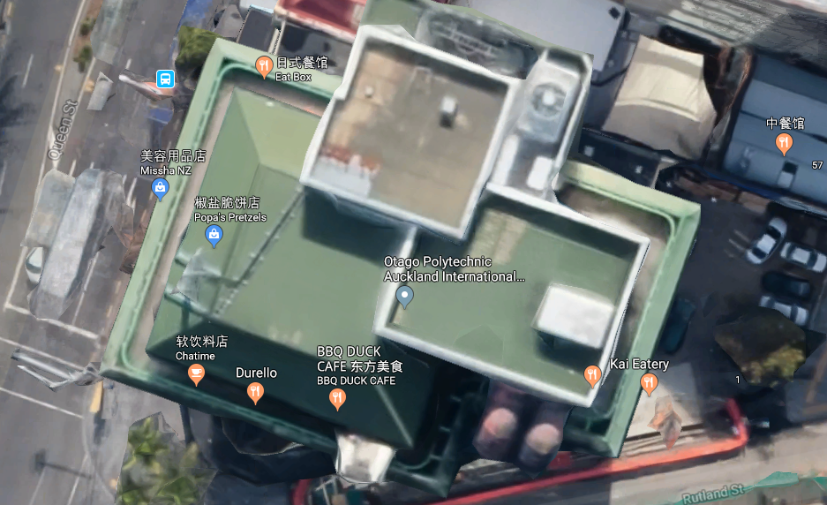
Sample SCOPE: Pt 3
Project risks:
Our first risk is achieving building consent. It is crucial for our project since we are constructing on existing building, if we could not achieve the consent due to technical or safety reasons, our project need to be re-scoped.
Finding professional builders who could finish all construction tasks within the fixed and tight time frame is another risk. As construction is required to be executed only during study holidays, to maximize the possibility of have all task accomplished within this short period (2 weeks), weekends need to be utilized as well. Moreover, different specialised builders need to fit in our tight schedule perfectly, any delay or incidence of the any work package might result in a significant delay of the whole project.
Weather is also a big risk which may bring turbulence to our project, especially the construction tasks relating to the rooftop reinforcement and waterproofing. Although we will take this risk into consideration and plan to protect the working site with PVC screen which can ensure the rain will not stop the construction, however once it is raining during the drying of concrete for reinforcing or if the rain caused linkage before the waterproofing starts, these finishing time of these tasks will be delayed.
Notes:
This is another example.
This example is of a house specification.

Slide 9
Methodology Applied to a project: Examples
1.2. Waterfall's Process
Waterfall has five stages which are analysis, design stage, execution or implementation stage, testing stage and the maintenance stage.
The Analysis stage. This stage which is also known as the system requirement specification (SRS) phase (Bassil, 2015) can be described in two ways in the context of IT. These are the system requirement and the software requirement. The system requirement deals with the establishment of the components for building the system. Examples are the hardware components, the software tools among others while the software requirements deal with the establishment of the functionality of the software. An example is a good user interface (Munassar &Govardhan, 2010).
The Design stage. The design stage also can be described in two ways in this context. That is the architectural design and the detailed design. The architectural design deals more with the framework of the software, their major components and how they interact with each other. The detailed design deals more with the specification of how each of the components defined in the architectural stage is implemented (Bassil, 2012). Again, the designing stage in IT deals with the choosing of the right design, logical diagram design, definition of data structure among others (Alshamrani & Bahattab, 2015).
The Execution stage. This stage talks about the conversion of the whole requirements into production (Alshamrani & Bahattab 2015). According to Munassar & Govardhan (2010), this stage is also called the coding and development stage where the detailed design is implemented. Again, It can be referred to as the implementation stage where the business requirements and specification is realised (Bassil, 2012).
The Testing stage. This stage is also known as verification and validation stage where the system is evaluated to determine if it satisfies the requirements that was specified. This can be done during or at the end of a development process of the software. (Bassil, 2012).
The Maintenance stage deals with the modification of the software solution with the purpose of refining output, error correction and some maintenance activities to improve performance and enhance quality. (Bassil, 2012).

Slide 10
Methodology Applied to a project: Examples
Main aspects of event management
Nowadays, the number of events carrying out around the world has been increasing year by year. Event industry has developed significantly, and an event itself has been becoming more complicated that result in more complicated event management (Allen, Harris, Jago, & Veal, 2000). Therefore, before to analyse the suitability of CCPM for the particular event, it is necessary to determine the main aspects of the modern event management.
As it was stated by Artem Voynov (one of the team member) in his individual report, according to O'Toole (2000) event project management has three main features:
The deadline, which undoubtedly defines the difference between event management and PM in different areas. Indeed, the event must start at a particular time even if something went wrong.
Widespread use of volunteers which points out the importance of behavioural issues and complicates the estimations of resources and tasks.
The changing and chaotic environment which requires to make decisions quickly, communicate them and carry them out.
The identification of the essential aspects of event project management creates a basis for critical analysis of CCPM which will be carried out in section 5.

Slide 11
Methodology Applied to a project: Examples
Conclusion
This research was aimed to determine the role of project management in achieving successful project outcomes and to analyse Critical Chain Project Management method which was chosen as the most appropriate method for event project management during the teamwork activities.
The research determined that that project management plays an indispensable role in successful outcomes for major projects. However, in order to implement all project management tools, it is crucial to understand the main features of a particular project. This study investigated, that event project management has three most crucial aspects, namely deadline, use of volunteers and changing environment. CCPM, having some disadvantages, such as aggressive management of the duration of tasks or complicated process of task prioritising, may undoubtedly help to mitigate mentioned problematic aspects of event management. As also stated above, CCPM is based on proper teamwork. Therefore, it is relevant to a wide range of Maori values, such as Whanaungtanga and Mohiotanga.
The finding of this study might be useful in the future execution of the mentioned case study and leave room for new research.

Slide 12
Maori Applied to a project: An example
A prototyping methodology
Providing constant interaction with users, in relation to Maori values, there is a strong connection, because one of the Iwi values is strong community relations: whanaugatanga means community relationship and family connections and awhinatanga means to give assistance and care for.
According to (Harmsworth, 2005), a number of good practices have been implemented by local authorities to develop effective relationships with Maori people. We extract some of the guidelines:
Recognise the importance of iwi/hapū participation in projects
Help build capacity and resources for iwi/hapū
Help develop mutually beneficial projects (e.g., council and Māori) – the development of projects that include stakeholders and community groups working together towards defined, measured and collective goals
A website approach
In website design, incorporate Maori symbols and greetings into the cover page, widgets and any places that can fit those graphics on the website.
Bilingual website platform: English and Maori. The website must be able to display Maori wordings in the English platform, as most of names in New Zealand are written in Maori language, such as locations, organizations, people and subjects that can only be explained in Maori words.
For project diversity, we seek opportunities for our OPAIC students to participate in project management with Maori organizations. This will bring a cultural diversity exposing our students to new knowledge, experience and relationships with iwi organizations.
Contribution to Maori community. We look for projects that contribute effort to iwi tribes, such as environmental reserve project and Maori community development.

Slide 13
Maori Applied to a project: Examples
A phased approach to a roof top café
Project Initiation: where the project objective is set with the sponsors, which is the additional floor above level eight for a rooftop café with fully functional kitchen and bar with outdoor garden ambience as the implementation of Maori Kitanga of Kaitiakitanga or guardian of nature conservation.
Project Planning: Since the interior incorporates Maori artworks, the need to consult each artwork to the Hapus inside the Iwi is considered critical and requires approval from the hapus.
Project Execution: Critical path methodology is implemented in planning using the Maori principle Manakitanga to include participation and collaboration amongst all parties.
Project Closure: Rangatiratanga will be observed when closing the project, and only those authorised to sign off the final project will do so.

Slide 14
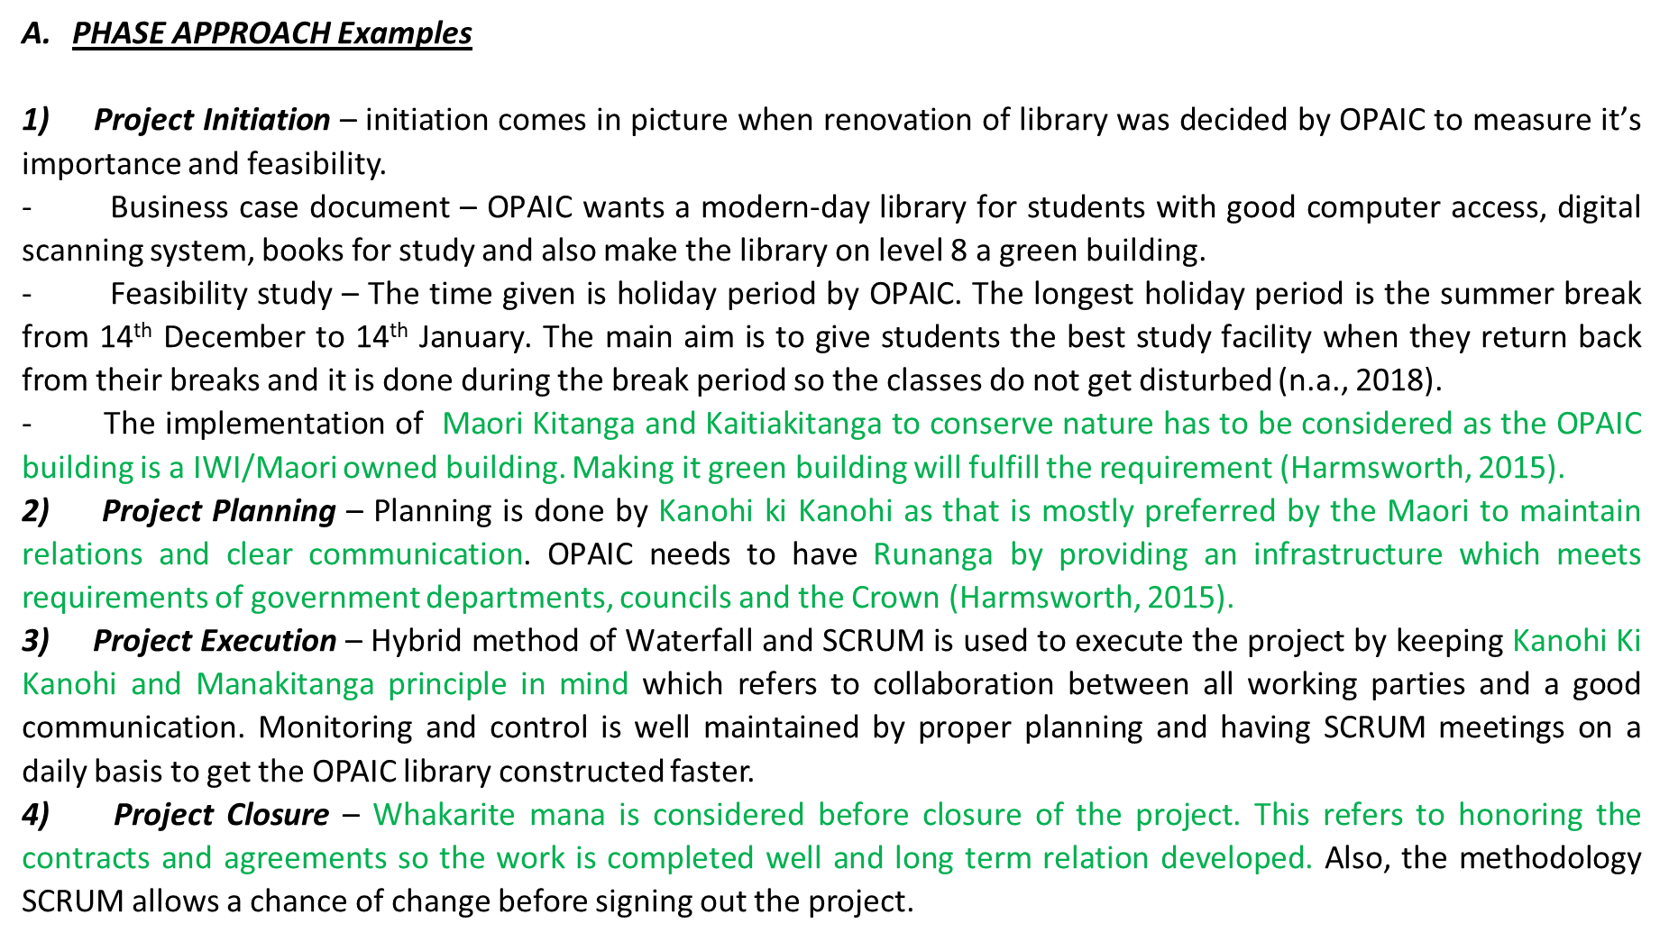
Maori Applied to a project: Examples

Slide 15
Types of Costs in a project
Direct Costs: Costs that are clearly changeable to a specific work package (labour, materials, equipment and other)
Direct (Project) Overhead Costs: Costs incurred that are directly tied to an identifiable project deliverable or work package (Salary, rents, supplies, specialised machinery)
General and Administrative Overhead Costs: Organisation costs indirectly linked to a specific package that are apportioned to the project
Notes:
Direct costs - Chargeable to a specific work package (paid as project progresses)
Direct overhead costs - Can be tied to project deliverables or work packages (e.g. PM salary, rental space)
G&A costs – org costs not directly linked to project (e.g. advertising, snr mgmt, etc)

Slide 16
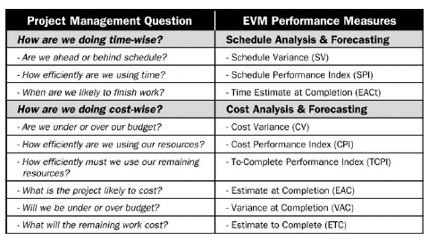
Types of control for a project: EV and basic PM questions
@PMBOK, 2000
Notes:
Earned value management analysis relates well to the kind of questions we ask when monitoring a project. Whilst there are many acronyms, once you get used to these they are easy to understand, and thankfully because they are longstanding financial criteria, most other managers in the business will understand what you mean.

Slide 17
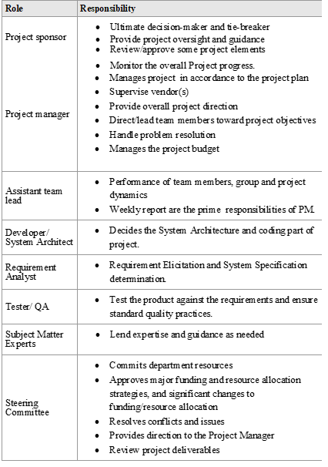
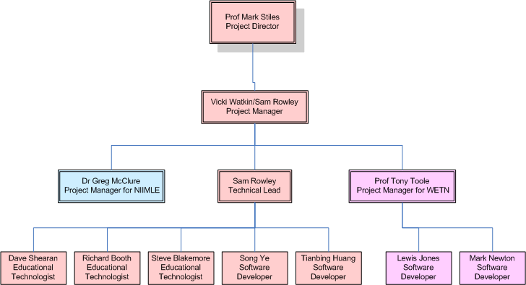
Project Organization Examples
Notes:
A recommendation following on from your project organisational chart is a list of responsibilities or job descriptions for team members.
So a little beyond the organisational chart.

Slide 18
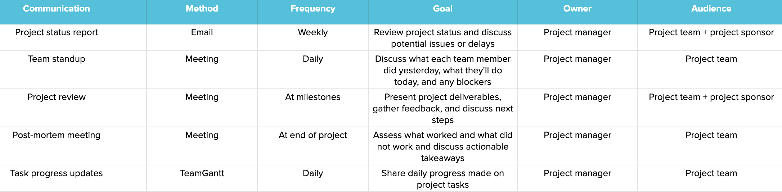
Communication plan Example
Notes:
A recommendation following on from your project organisational chart is a list of responsibilities or job descriptions for team members.
So a little beyond the organisational chart.

Slide 19
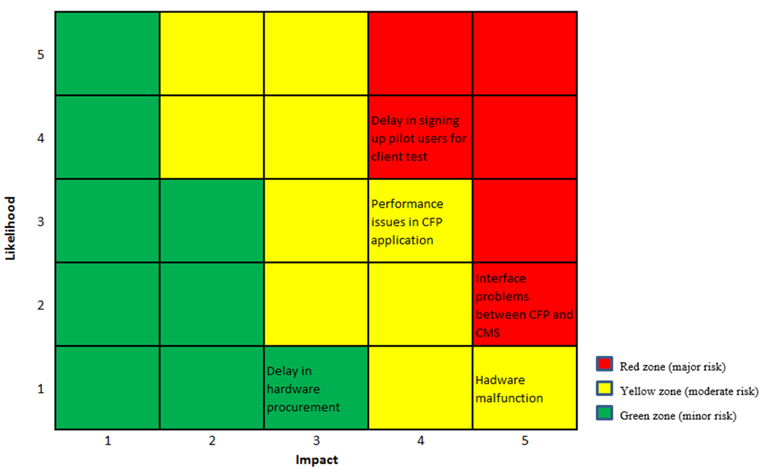
Risk severity matrix
Notes:
Gantt charts provide definite advantages when reporting on a project.
Most executives understand reporting against a Gantt chart, and they are useful tools to show groups of milestones and demonstrate individual resource use.

Slide 20
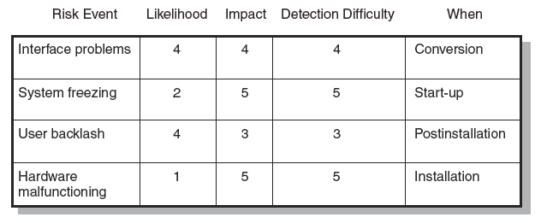
Risk assessment
Failure Mode and Effects Analysis (FMEA) Impact × Probability × Detection = Risk Value
Notes:
There are however many disadvantages, and these are why professional planners prefer to use the Work Breakdown Structure.

Slide 21

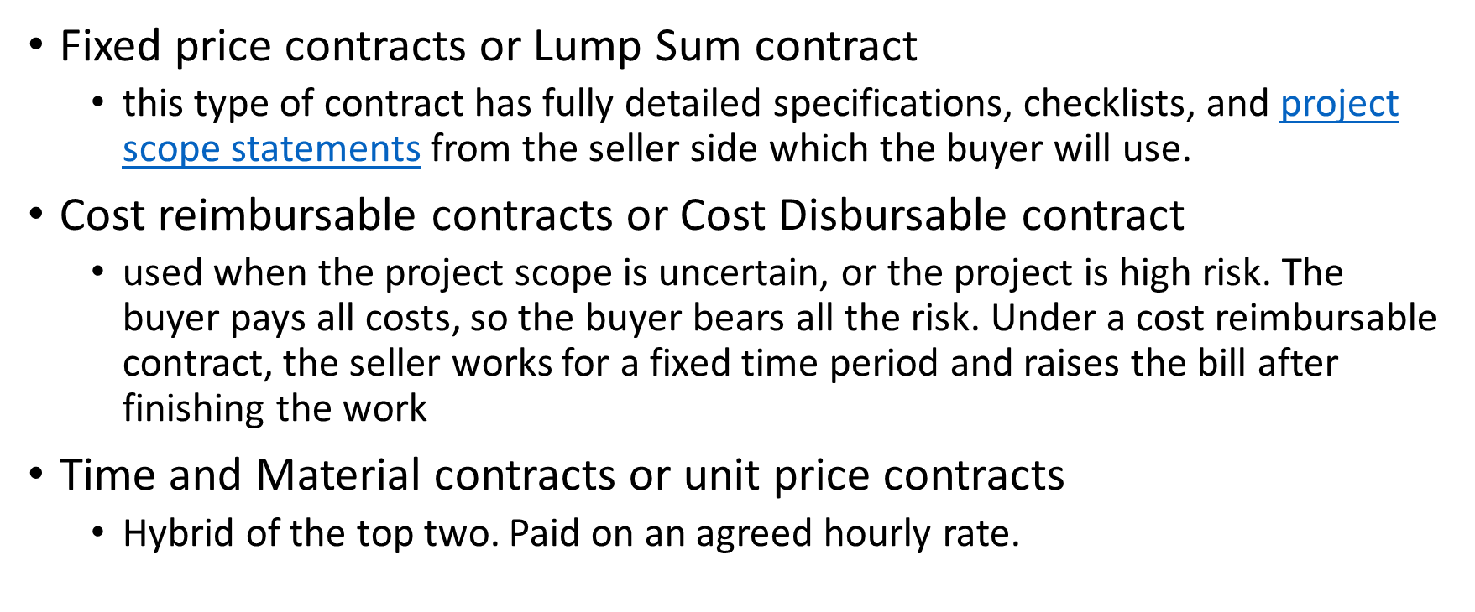


Slide 22
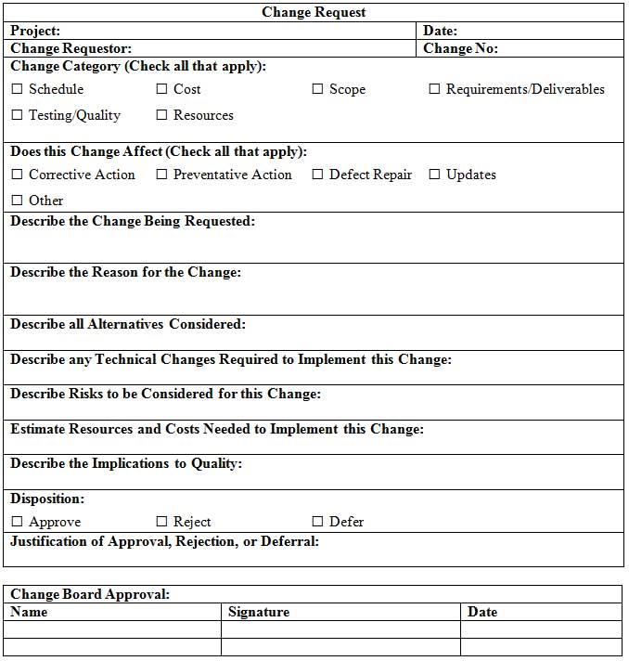
Sample Change control form
Notes:
With standardized forms used in most projects.

Slide 23
Duties of the termination manager
Ensure completion of the work, including tasks by subcontractors
Notify the client of project completion and ensure delivery is accomplished.
Gain acknowledgment by the client
Ensure documentation is complete, prepare final report
Clear final billings and send invoices to client
Redistribute personnel, materials, equipment to appropriate places
Clear project with legal counsel of consultant. Record and archive all documents
Determine what records to keep, and store in the proper places
Ascertain any product support requirements, decide how much support will be delivered, and assign ongoing responsibility
Oversee the closing of the projects books

Slide 24
Gantt Chart:
Notes:
Unlike the Gantt chart which shows a list of work to be done, the Work Breakdown or Gazinto chart, shows the relationship between all the parts of work.
The Gazinto or Work Breakdown chart was produced later than the Gantt chart, and is used less than a Gantt chart in general practice.
However, this it is important to understand the relationships between the parts of work to be done, and this is often a point of project failure when the work hierarchy and relationships change throughout the course of a project.
Gantt chart developed in 1917 by Henry L Gantt, a pioneer in the field of scientific management. Gantt shows planned and actual progress for a number of tasks displayed as bars against a horizontal time scale. Its an easy to read format.
There are several advantages of using a Gantt chart;
They are easy to understand.
They are easy to update – as long as no major changes are wanted.
Provides a good picture of the current state of the project.
A Gantt chart is a type of network diagram and is an easy visual to read.
BUT – they are also used as a to do list and not linked up well enough to run a project on.

Slide 25
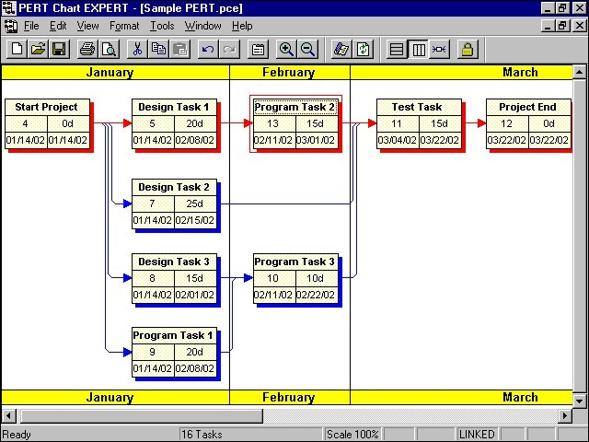
Work Breakdown Structure Example PERT style (Performance evaluation and review technique)
Notes:
This is a computer generated example of a typical work breakdown structure, and in case its in a PERT style, and is useful to see the colour coding so that we can easily assess what is a project, a subproject, main work packages and other work packages involved in these areas – each of which will be references and owned by someone.
This is a similar view to the one we would get if we used the Microsoft Project software product most often used by project managers in industry.

